Slide 1
WELCOME TO BRAMCOTE HILLS PRIMARY SCHOOL
Make the Future Better for All

Slide 2
WELCOME TO BRAMCOTE HILLS PRIMARY SCHOOL
Home - Bramcote Hills Primary School
Make the Future Better for All

Slide 3
WELCOME TO BRAMCOTE HILLS PRIMARY SCHOOL
Make the Future Better for All

Slide 4
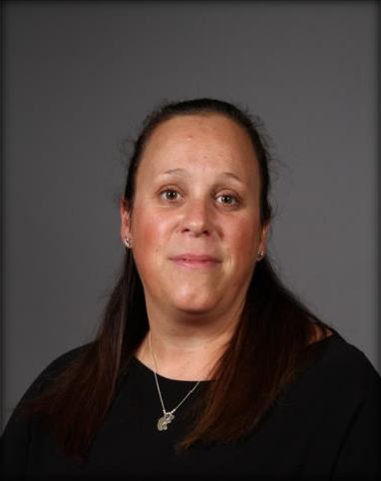

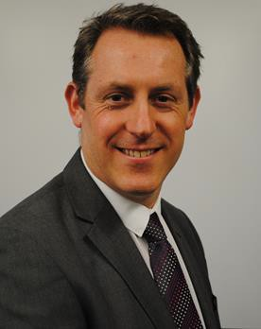
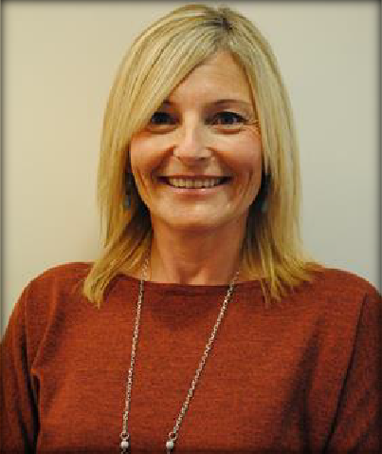
WHO’S WHO?
Mrs Kerry White
Deputy Headteacher
Mr. Pete Taylor
Headteacher
Mrs. Sue Hewes
Assistant Headteacher

Slide 5
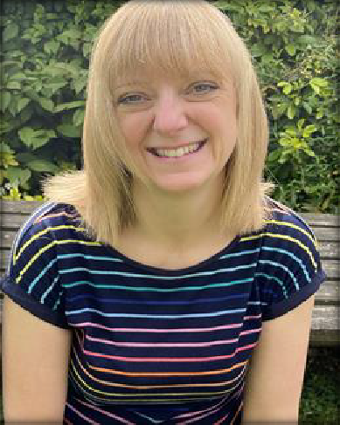
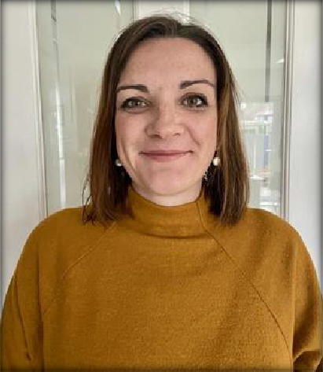
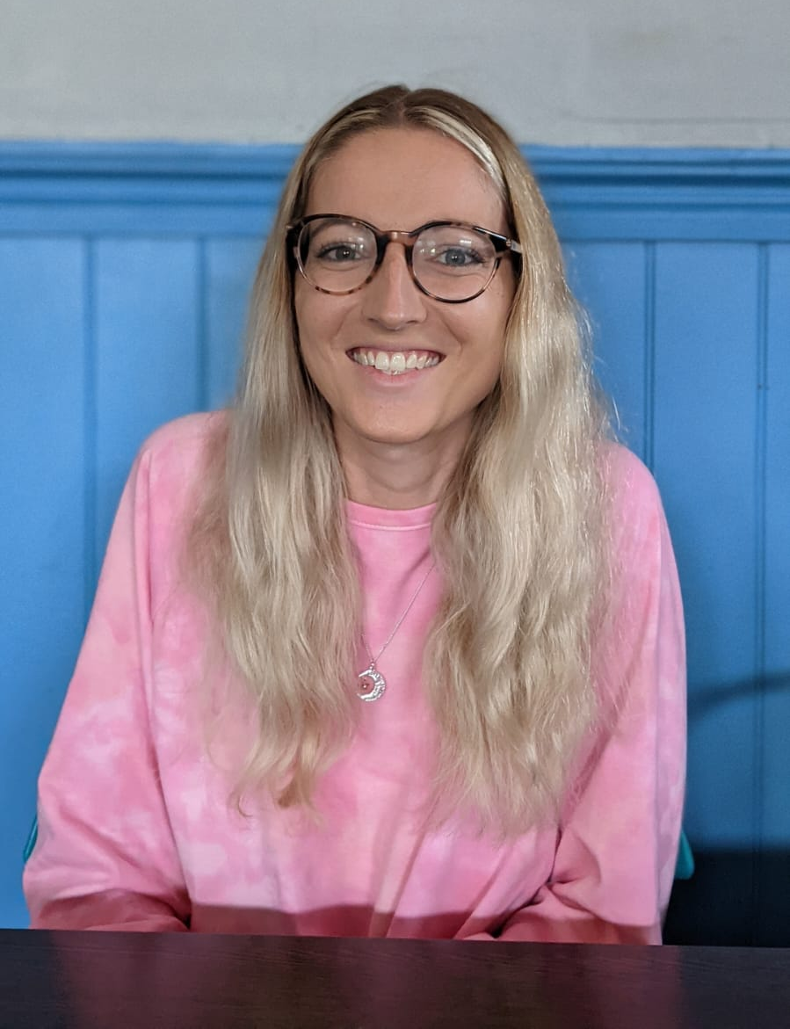
FOUNDATION TEAM
Mrs Flewitt
Foundation Lead and Diamonds Teacher
Mrs Barnes
Diamonds Teacher
Miss Hobson Sapphires Teacher

Slide 6
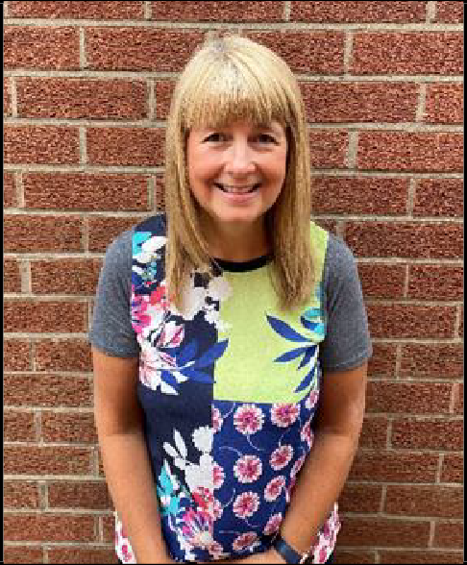
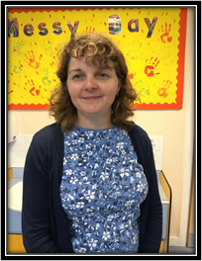
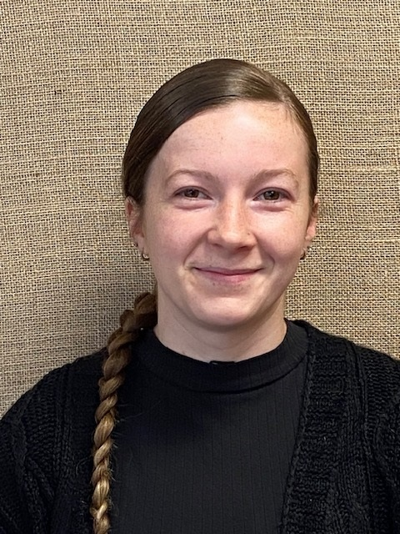
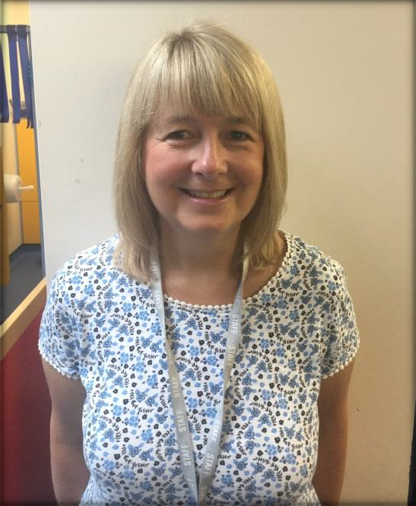
TEACHING ASSISTANTS and CARE ASSISTANTS
Miss Lawson Mrs Hessey
Mrs Holloway

Slide 7
OTHER SUPPORT STAFF
There are numerous other key staff who you will meet or be aware of.
Our Office staff – Mrs Niven, Miss Clowes, Mrs Saeed and Mrs Smith
Our Midday Supervisors who look after the children at lunchtime
Our premises staff, who maintain and develop our building
Our Governors who help to lead the school, maybe you might be interested in becoming a parent governor in the future
Although not staff, our PTA (Parent Teacher Association) do valuable work for the school and you may be interested in volunteering to help them. They organise social events and raise money for valuable school equipment.

Slide 8
BRAMCOTE BELIEFS
We believe in delivering an exciting and broad curriculum through high quality teaching and innovation
We believe in having high standards
We believe in developing and knowing children as individuals
We believe in enabling pupils to become well-rounded, happy and confident children who achieve to the best of their ability
We believe in being inclusive so that all children can thrive
We believe in working in partnership with our community and other schools

Slide 9
OUR SPARK CURRICULUM
Stimulating
Purposeful
Aspirational
Relevant
Knowledge based

Slide 10
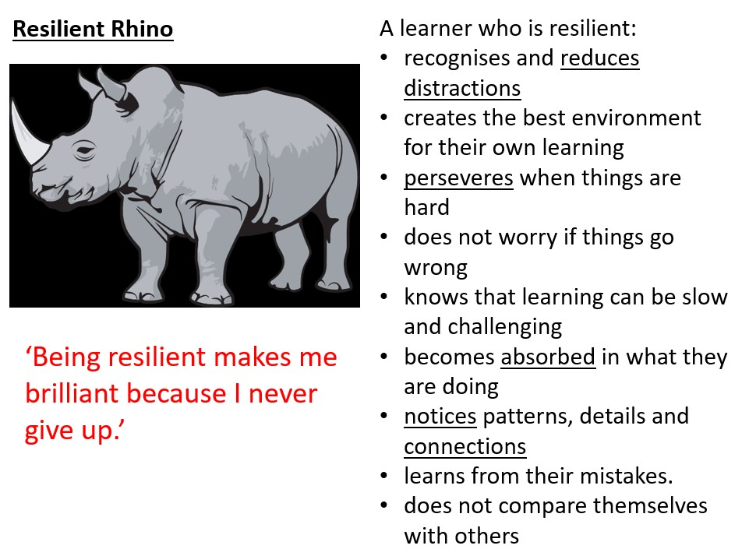
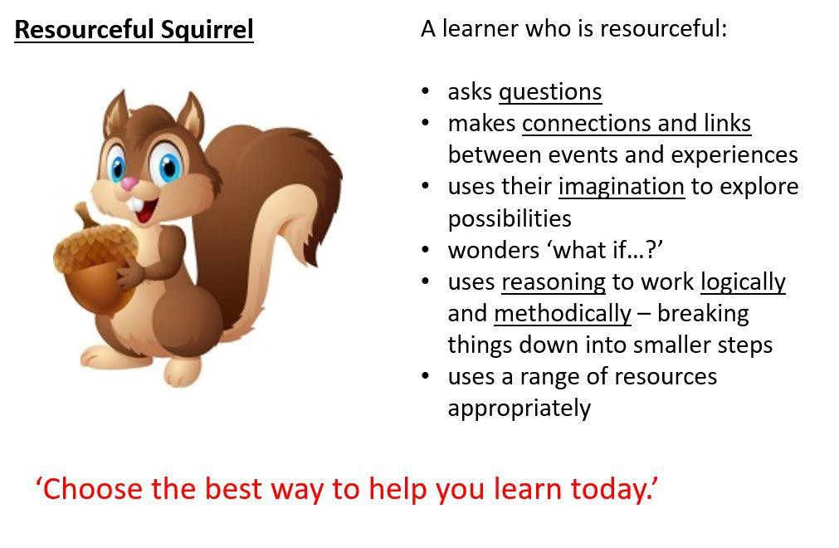
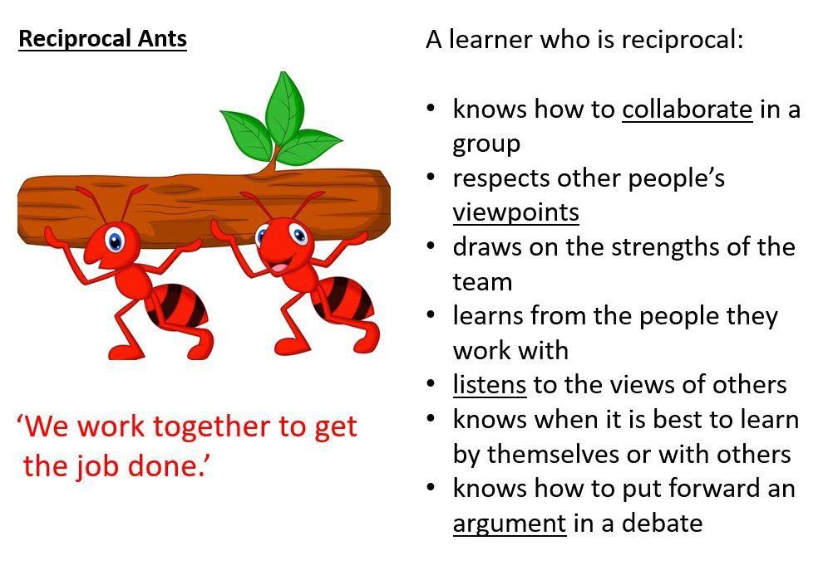
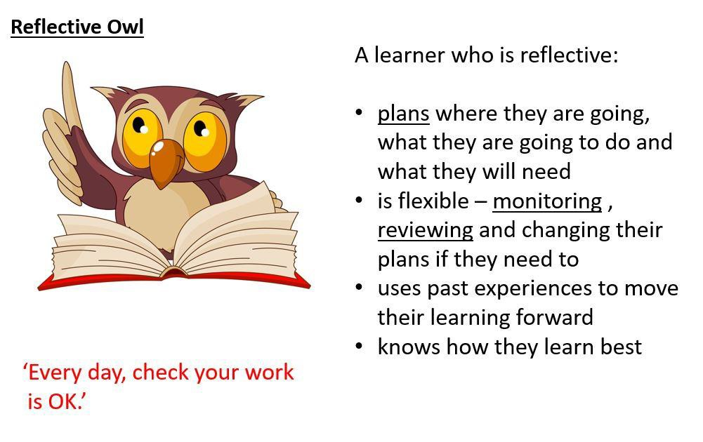
OUR LEARNING POWERS THE 4 RS

Slide 11
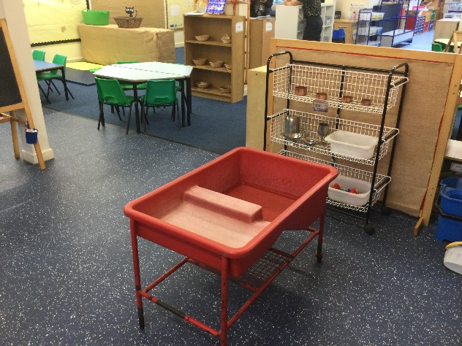
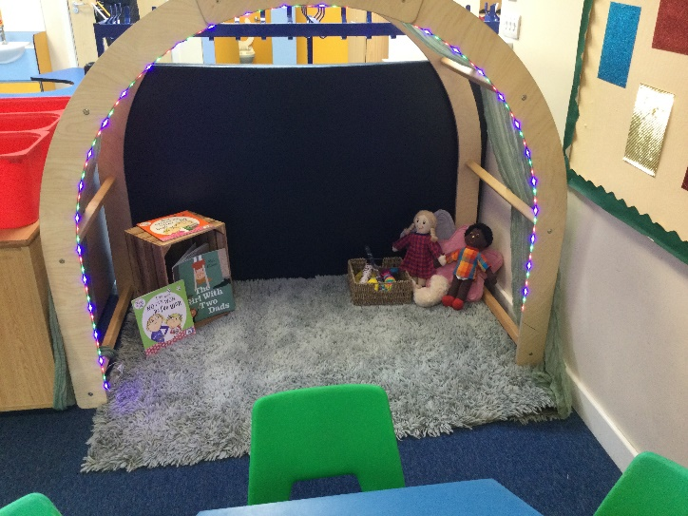
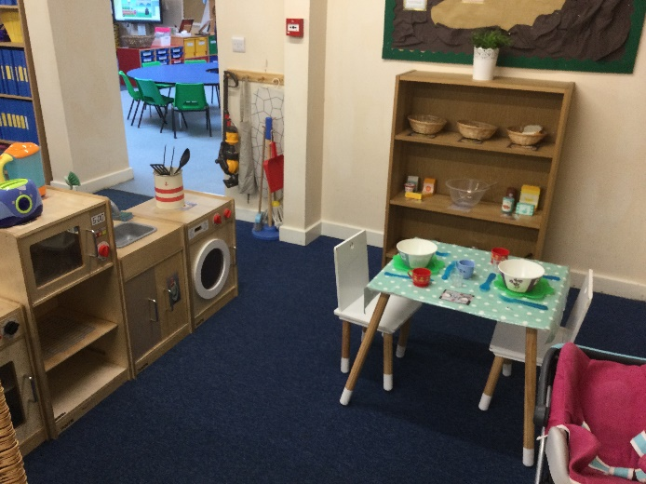
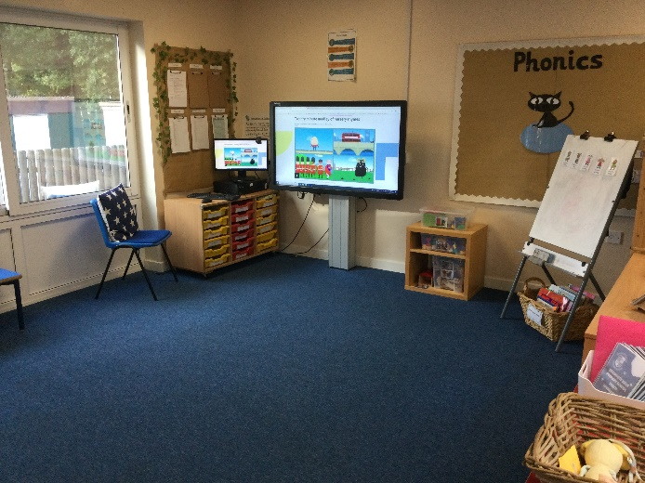
INDUCTION FOR YOUR CHILD
We have provided you with the induction dates for the end of this term and start of the Autumn term
Children have been allocated a group, group A, B, or C for Stay and Play afternoons. They have been put into two groups for the Story Time afternoons (Ladybirds or Butterflies). These will not be their final class groupings which will be either Sapphires or Diamonds.

Slide 12
Induction Programme
Welcome meeting | Thursday 10th June 6.00pm
 | A | B | C
Stay and Play | Tues 16th June 2.00 – 2.50pm | Weds 17th June 2.00-2.50pm | Weds 24th June 2.00-2.50pm
Story Time 1 | Ladybird Tues 30th 2.00-2.50 | Butterfly Weds 1st July 2.00-2.50
Story Time 2 | Weds 8th July 2.00-2.50 | Tues 7th July 2.00-2.50
You will then be notified of whether your child is to join the Sapphires or Diamonds.
New Classes | Sapphires | Diamonds
Story Time | Fri 17th July 2.00 – 2:50 | Thurs 16th 2.00-2:50

Slide 13
Additional Opportunity – Park Visit
We would like to invite all children and parents/carers to a get together at Bramcote Park Playground on Monday 20th July 10.00-11.00am.
This will provide an informal opportunity for children to play together and for adults and children to chat to Foundation staff.
It is not compulsory, but we would love to see you there if you can make it.

Slide 14
September 2026
Tuesday 1st September INSET Day
Half Day Visits – Diamonds 8:40 – 11:20am Sapphires 12:20 – 3:10pm
Wednesday 2nd, Thursday 3rd, Friday 4th, Monday 7th September,
Meet the Team - Parents/Carers only in school to start at 5.30pm Thursday 3rd September
Full Time Starts on Tuesday 8th September – 8:40am to 3:10pm

Slide 15
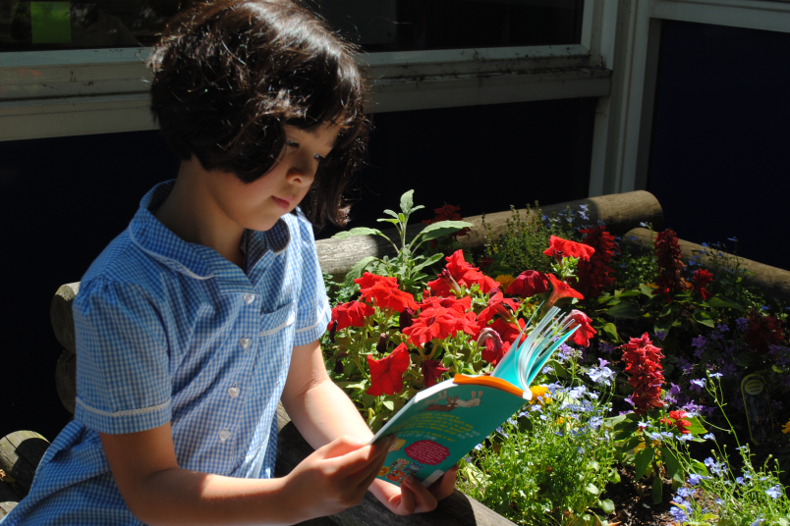
ITEMS TO RETURN AT STAY & PLAY VISITS
Home information sheet and Emergency Contact Sheet (we have some of these – please return as soon as possible) (NB Please declare all languages spoken in the home (EAL) - we see this as a strength)
Your child’s birth certificate (to be brought in for the Stay and Play visits)
'All About Me’ forms (we have some – please return if you have not done so already)
Acceptable Use Reply Slip (We have some – please return if you have not done so already)
Cool Milk form. Please do this online.
PTA information (optional)
Online return Parent/Carer Consent Form Medical Needs
(QR Codes)

Slide 16
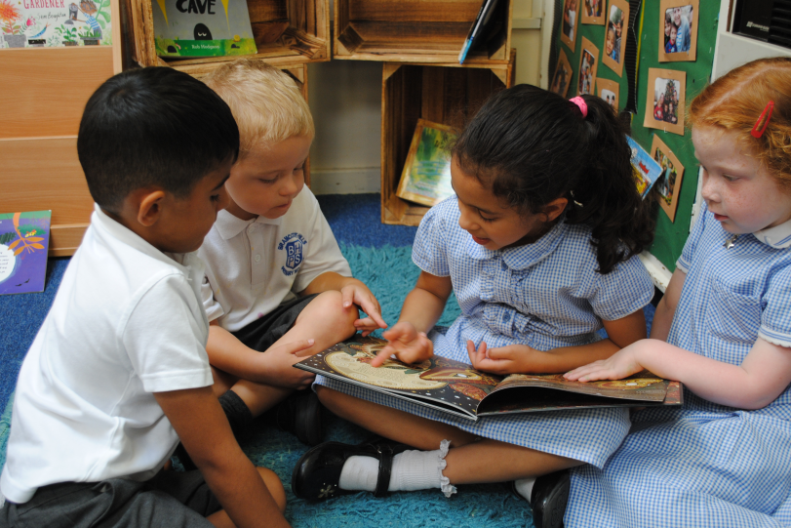
MORE INFORMATION
Welcome to the Foundation Stage
Attendance and Punctuality
Uniform, PE kit and shoes
Starting Reception
Privacy Notice
Sunrise Breakfast Club & Kids’ Club
Holiday Dates
INSET Days
Free School Meal Claims
Good Behaviour Code
Safeguarding Children Procedures
Promoting Equality
Parking

Slide 17
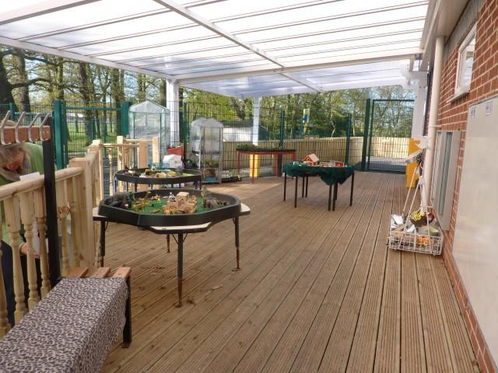
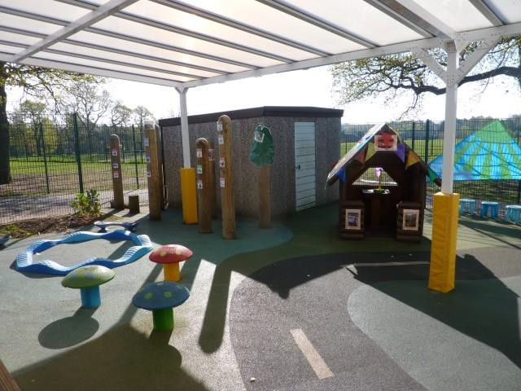
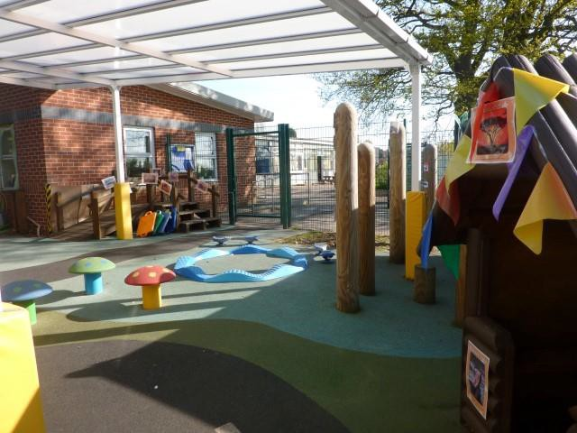
Toileting - Please encourage children to use the toilet independently. Please teach your child to be able to wipe themselves with toilet paper.
Eating. Foundation children eat in the dining room with no other classes. There are a number of MSAs who support the children and Foundation staff also provide support for first couple of weeks too. A member of Foundation stage staff will be present every day after that, for the first term, however, we do expect children to be able to feed themselves, preferably using cutlery. We encourage children to eat and try new things. All children are entitled to free universal school meals.
Medical needs and allergies
Starting Reception Please see sheet in welcome pack with ideas on what you can do to support with their readiness for school

Slide 18
WHAT NEXT?
Parents/Carers can remain in contact with school via the office email address office@bramcotehills.notts.sch.uk FAO Mrs Flewitt.
We will post any further information on the school website, see www.bramcotehills.org- Our School – Early Years Foundation Stage - New Starters New Starters 2026 -27

Slide 19
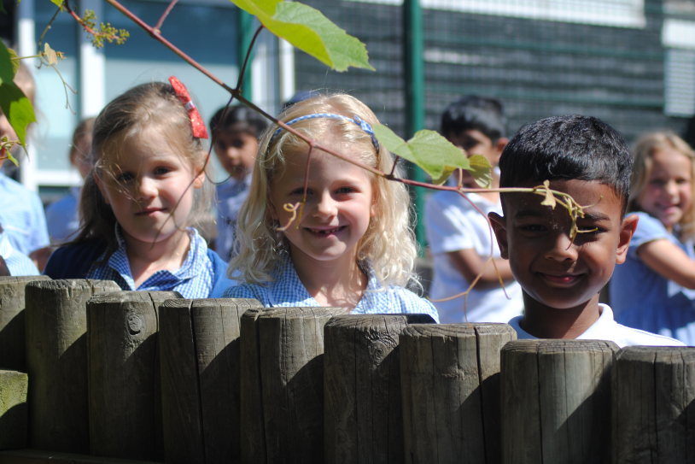
BRAMCOTE HILLS PRIMARY SCHOOL
Make the Future Better for All

Slide 20
