Slide 1



Broxtowe Mental Health Support Team (MHST)
With
Beth Foster-Hunter
Education mental health practitioner (EMHP)
MENTAL HEALTH
& WELLBEING
WORKSHOP
Notes:
Brief introduction of who we are.
We will be discussing some sensitive topics today, so if you need to step out of the room at any point please do, or feel free to chat to one of us.
If at any point you are drawing on experience from a particular child please

Slide 2



Aims and Objectives
WHO ARE THE MENTAL HEALTH SUPPORT TEAM?
SUPPORT AND GUIDANCE
HOW AND WHEN TO REFER
ANXIETY AND LOW MOOD IN CHILDREN
Notes:
What are we going to cover with this session:
Introduction to the MHST
Understanding mental health
Identifying potential indicators of mental ill health
Touch on staff wellbeing
Our aim is to bridge the gap between Education and Healthcare.
Schools are so important for CYP.

Slide 3

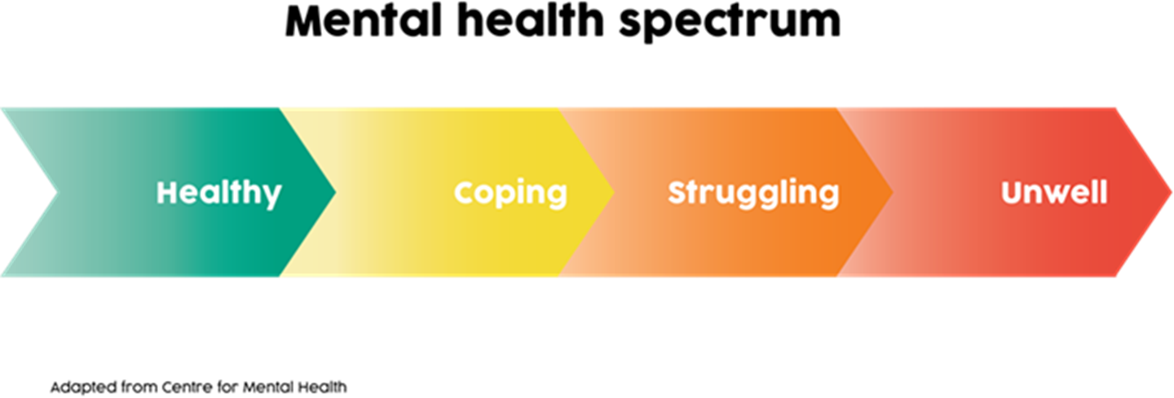
We all have mental health
Our mental health is made up of our thoughts, emotions, moods and behaviours...
Notes:
Everyone moves up and down this spectrum at different points in their life, and different things can cause this. Our main aim is to teach coping skills and promote good mental wellbeing.

Slide 4
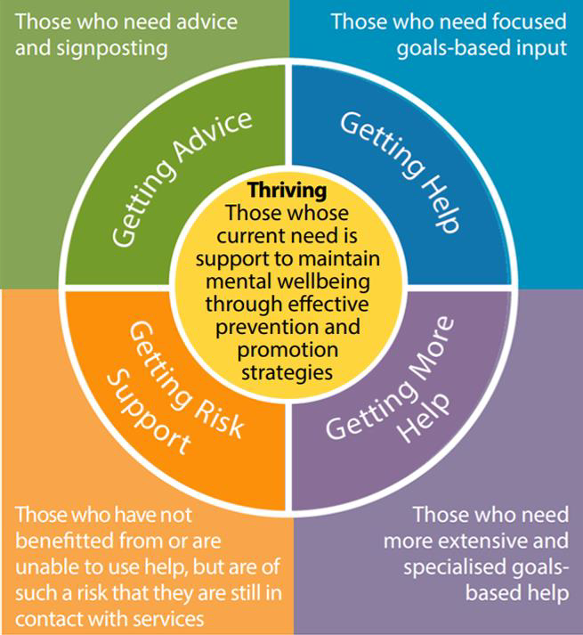

How can the MHST help?
Supporting those in Healthy by promoting good mental health
Supporting Coping children who may need advice through workshops/self-help methods
Supporting those Struggling who might need more targeted, goal-based support
Helping to refer Unwell children who might need extra support to specialist services
Notes:
Around 80% of children at any one time are experiencing the normal ups and downs of life but do not need individualised advice or support around their mental health issues. They are considered to be in the Thriving group. They would benefit from preventative measures, or promotion of mental health
Others may be experiencing mild or temporary difficulties, such as a result of COVID and are managing their own health and not wanting/needing goals-based specialist input. They may benefit from signposting to other services.
Other children may benefit from focused, evidence-based help and support, with clear aims, and criteria for assessing whether these aims have been achieved. Such as the support provided by the MHST.
There may be some who require more specialist support.

Slide 5

WHAT HAS BROUGHT YOU HERE TODAY?
Notes:
Take a moment to think about (or to share), so by the end you know if your needs/questions have been reached.

Slide 6
Anxiety Discussion
What is Anxiety?
What might children & young people get anxious about?
How would you notice it?

Slide 7
Some things children get anxious about…
  Exams/Tests
  Breakdown of relationships
  Something terrible happening to them/caregiver/parent
  Specific things such as spiders or heights
  How other people perceive them
  Anything and everything- all day, everyday
Notes:
Smoke alarm analogy- anxiety is like when smoke alarm goes off for slightly burnt toast
Any more examples of what children get anxious about?

Slide 8

What might you notice?
Avoidance
Toileting Issues
Unexplained/repeated stomach aches/headaches
Faster breathing/heart rate, shaking, sickness
Reassurance seeking: ‘Am I ok?’ ‘ Will Mum be ok?’
Separation Anxiety
Difficulty sleeping
Refusing to go to school
Frustration/Aggressive Behaviours
Notes:
Any more?
-concentration/memory

Slide 9
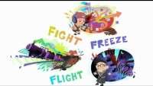
What is Anxiety?
Notes:
Fight Flight Freeze – A Guide to Anxiety for Kids - YouTube

Slide 10

WHEN IS Anxiety A PROBLEM?
WHAT IS ANXIETY?
Our body's response to perceived danger
Feelings of unease, worry or fear
Emotions Thoughts or
Physical Sensations
A personal smoke alarm
Notes:
Smoke alarm analogy- problem anxiety is like when smoke alarm goes off for slightly burnt toast instead of a fire

Slide 11

A word on depression
Sometimes there may be a trigger or "cause" for depression, such as:
Bereavement
Struggling at school
Changes at home
Physical Issue: Thyroid/Vitamin Deficiency
Family history of depression
BUT
Depression can also happen for no obvious reason
Notes:
-Is rarer than anxiety in primary aged children- always GP first if no obvious ‘cause’/ ‘trigger’
-IT IS DIFFERENT FROM FEELING FED UP OR SAD FOR A FEW DAYS: Persistent sadness for weeks/months

Slide 12
So…
How can you help?
What do you already find helpful?
Notes:
Explore wellbeing tools already in place through discussion

Slide 13
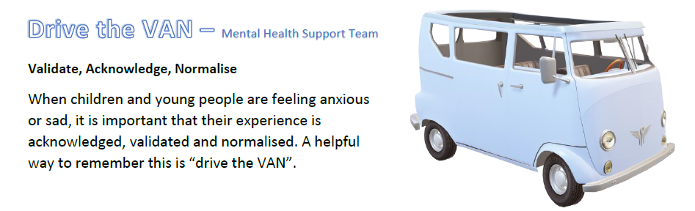
How can you help?
1. remain calm and listen

Slide 14
How can you help?
2. Coping strategies
Problem
Solving
Self-Soothe Techniques
Create a Self-Soothe Box

Slide 15
Problem Solving
Find
Find the core problem
E.g: I don’t know my 7’s and the test is tomorrow
List
List together ALL solutions to this problem
(However ridiculous/silly)
Explore
Go through each solution together
Decide
Help the child decide which course of action is the best for them
Notes:
This method can :
Create humour in the silliness and automatically reduce the stress in the moment
Help the child/yp see that someone will help them if they have a real problem (rather than a hypothetical one)
Helps them learn how to problem solve and decide-creating confidence and autonomy

Slide 16
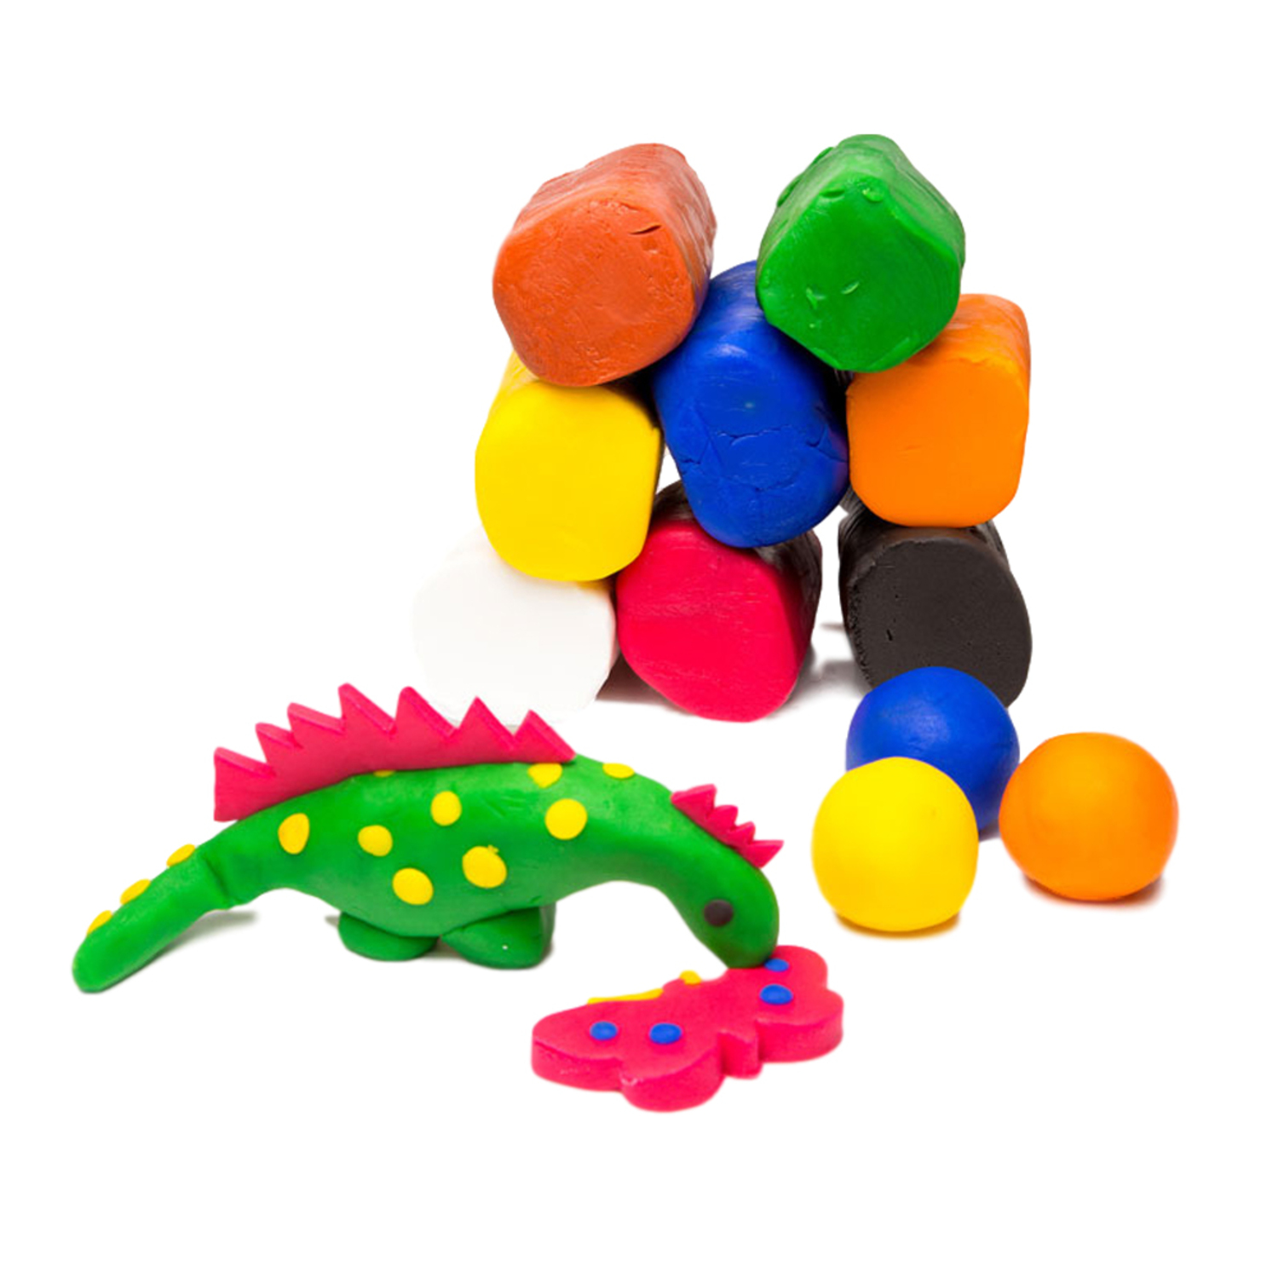







Self-soothe techniques
Go outside -
walk, run or sit
Push the wall
Squash & squeeze
Write down distressing thoughts or feelings then destroy them
Hitting a pillow/cushion or boxing bag
Listen to music or watch a film
Take a minute
& breathe
Colouring or puzzle books
Notes:
Physical are good for the fight and flight response
Less physical are good for the freezers
Any other good ones?...

Slide 17

The sensory hand
Notes:
With Handout-activity (optional)

Slide 18
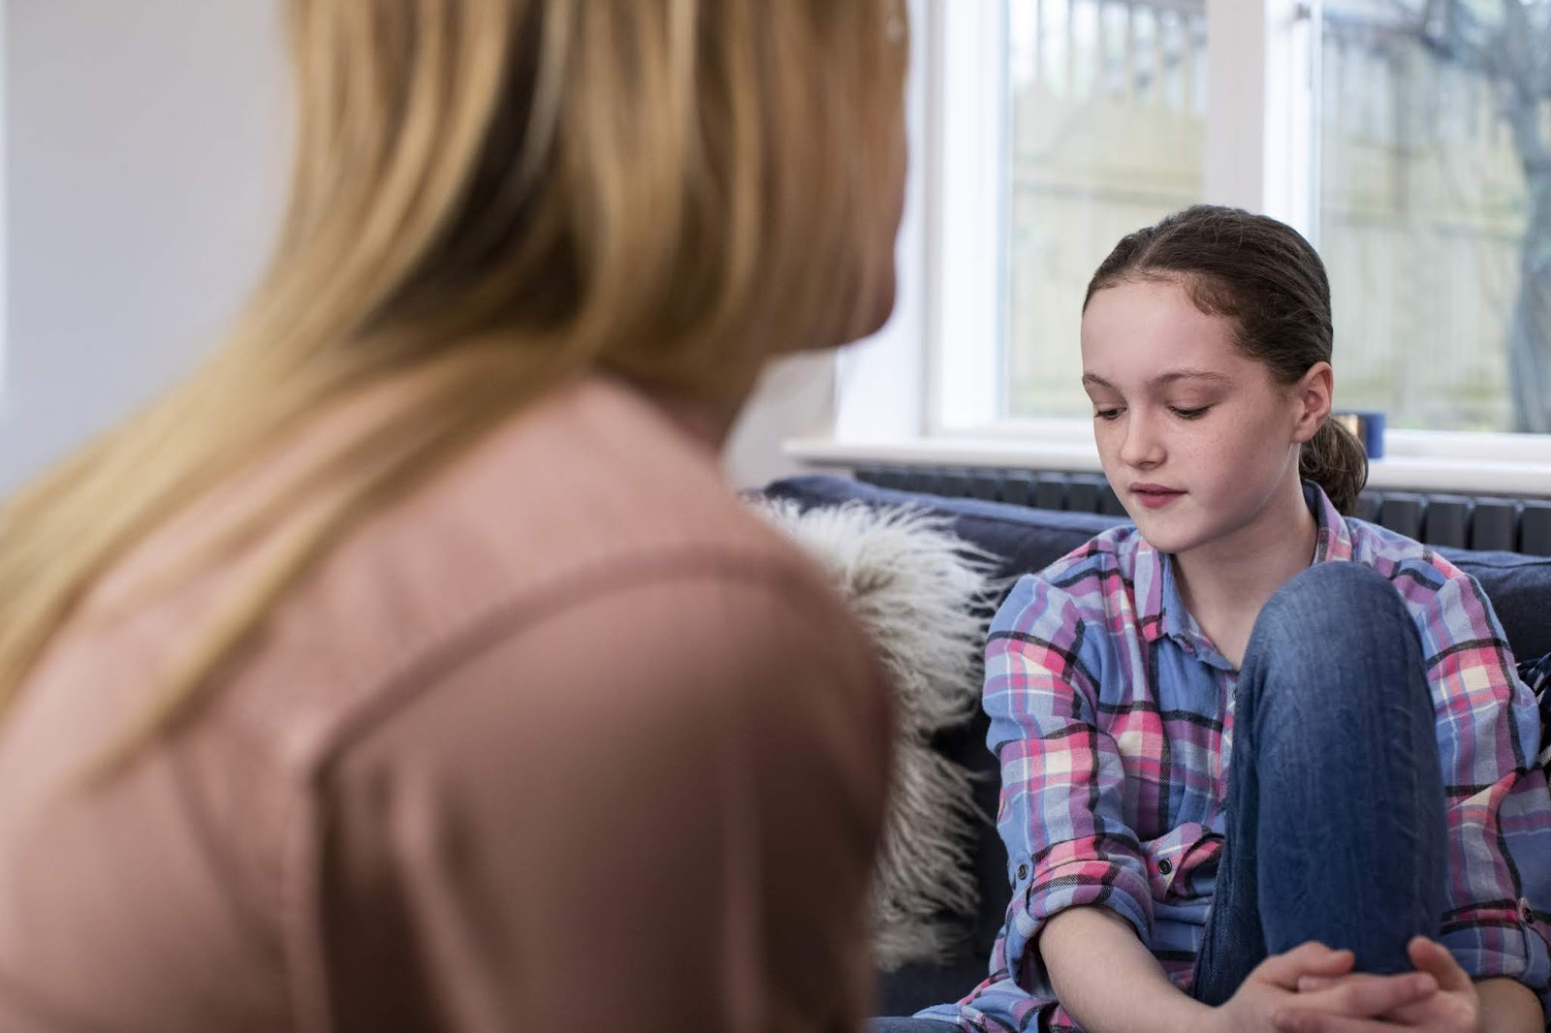
How can you help?
3. check in/ talk time
Notes:
Depending on the need, you can introduce talk time once a week, same time/place:
-helps child know they have support and understand that others can help them
-helps child get used to talking about emotions if they struggle to initiate
-try not to do it less than 2 hours before bed
-get school involved too (a TA or chosen adult)

Slide 19
When should you refer to the us?
Notes:
Discuss

Slide 20
When to refer to the US...
It is having a big impact on their life
You/school have offered support which hasn’t helped
You have explored potential practical problems
The child wants further support
There is a therapy goal in mind
Notes:
Specific goal – targeted area of improvement, not just generally wanting someone to talk to.

Slide 21
What do we need from you?
Informed Consent from yourself & child
Brief details of the presenting problem
Brief details of previous and current support
Safeguarding/risk concerns
Special needs/disability information
Child, School and Family voice
You can ask school to refer or self-refer:
CAMHS Self-referral (nottinghamshirehealthcare.nhs.uk)
Notes:
-Link to
-Do not need to fill in all in great detail, just as much as you have so we can get started
Consent can be verbal but this should be noted on the form

Slide 22
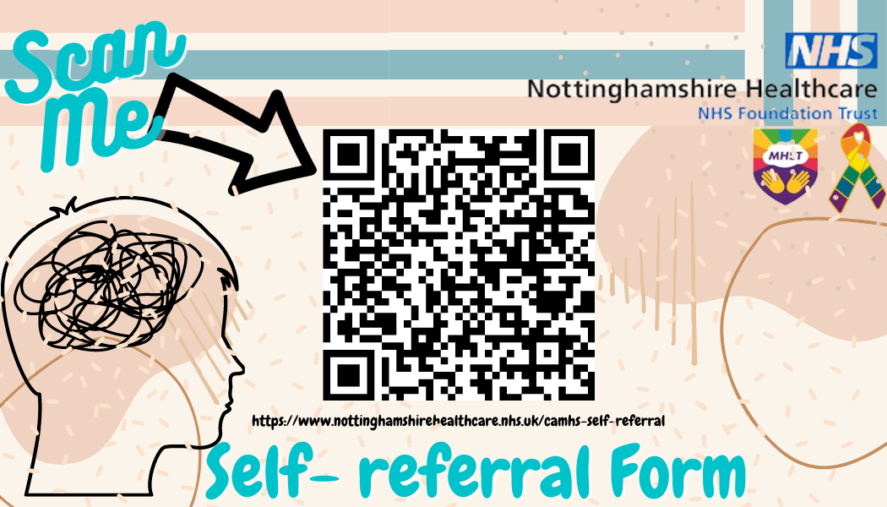

Slide 23

Thank you for listening!

